Slide 1
Collaborative Source Code Review
Team 17
Wenxuan Xu, Weitong Zhang, Jinyi Li, Jiaxin Chen

Slide 2
Presentation Agenda
Project Background & Team Work Allocation
Original Goal for Sprint 1
What we’ve completed in Sprint 1 & Demo
Process & Problem and Solution
Goal for Sprint 2

Slide 3
Project Background
Current Issues:
  Reviewers lack the ability to record and share their thoughts.
  Code navigation in projects containing a large set of files is very difficult.
  Uploaded file will not be automatically reformatted if the original format of src doc is malformed.
  No highlight syntax supported yet.
Goal of our project:
  Provide a platform for code reviewers to collaborate and share code from large codebases.
  Upload source code or link of a Github repo
  Navigation between files
  Code format and highlight according to language
  Freely add contributor

Slide 4
Team Work Allocation
Account management
  Jinyi / Wenxuan / Jiaxin
Code review
  Jiaxin / Weitong / Wenxuan
Code navigation
  Jinyi / Weitong
Code review statistics dashboard
  Jiaxin / Wenxuan
Repository management
  Jinyi / Weitong

Slide 5
Original Goal for Sprint 1
Refactor html pages
User authentication to gain access
User profile display and editing
Add and edit line-level comments
Create stat dashboard for user activity (visualized table)
  # of comment
  # of visits
  Etc
Syntax highlight

Slide 6

What we’ve completed in Sprint 1 & Demo
Refactor html pages
User authentication to gain access
User profile display and editing
Repository management & Syntax highlight
Create stat dashboard for user activity (visualized table)
  # of comments
  # of visits
  Etc

Slide 7
Process & Problems
Finished basic User management
Profile display, update and stat dashboard
Finished basic Repository management
Ownership, Reviewers
File upload and highlight syntax
Problem: Send invitation to a future user
User has not registered, but we need to keep track of the sender and receiver
Problem: Add in line comment
We encountered some problems with the database during fetch/rebase

Slide 8
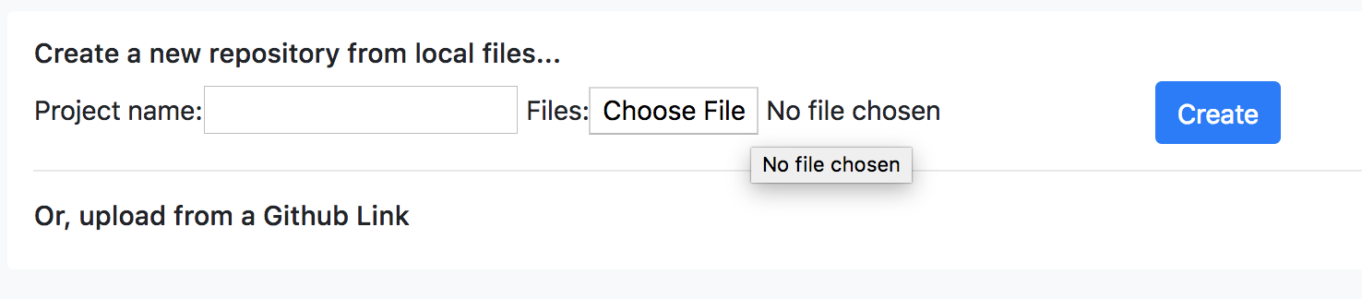
Goals for the 2nd sprint
File upload
  Single file upload => multi-file upload (a project folder/a tarball)
  Upload files from the user’s Github repo

Slide 9
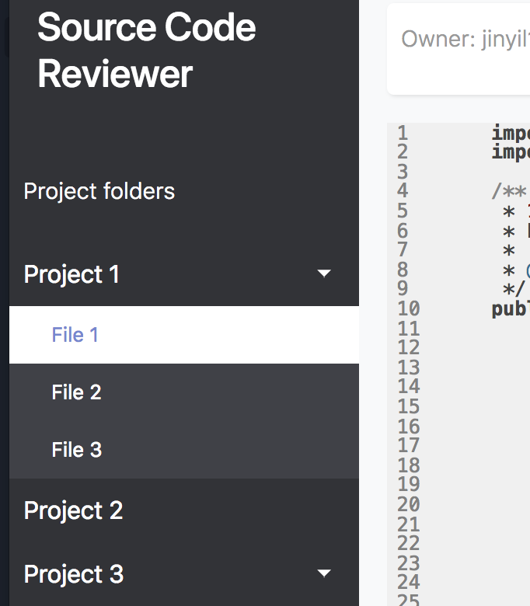
Goals for the 2nd sprint
File management
  Implement a file folder tree like this...

Slide 10
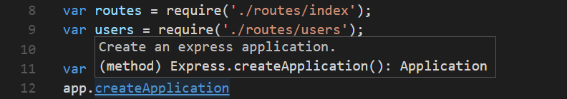
Goals for the 2nd sprint
Code navigation
  Navigate between functions within the same file
  Navigate between files
    How to identify a function?
    How to locate a function?

Slide 11




Goals for the 2nd sprint
Support Multiple languages

